Slide 1

Smart agricultural system Ece5042 - MICROCONTROLLER ARCHITECTURE AND ORGANISATION PROJECT
B roHITH 20mes0038
SHRUTI GHADGE 20MES0050
AJITH KUMAR R 20MES0052

Slide 2
OBJECTIVE
To Design a Smart Agriculture Product to automate irrigation, lighting and provide useful weather insights
To design a scalable and marketable embedded device
To learn the ARM architecture and how to develop products with it
To try the Embedded programming language Rust
To learn to use the HAL Libraries

Slide 3
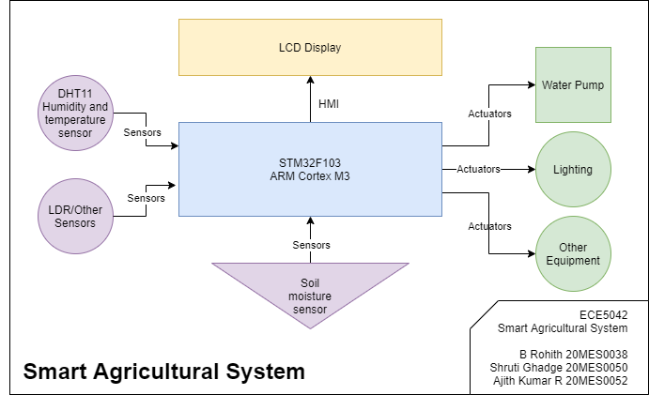
Block diagram

Slide 4
components
Hardware
Software
STM32F103C8^{[1]}, based on ARM Cortex-M3, commonly known as the blue pill
ST-LinkV2, SWD to USB adapter for Debugging
LCD Display to show status and offer a basic HMI
Capacitive Soil Moisture Sensor
DHT-11 Humidity and Temperature Sensor
A mini water pump for demo
A Bulb or LED for realising lighting control
Rust^{[2]} Toolchain for programming in Rust
ARM Toolchain for Cross-Compiling
OpenOCD^{[3]}/GDB^{[4]} for Breakpoint/Watchpoint Monitoring and Debugging
HAL Library Crates^{[5]} for STM32F103 specific Hardware Abstraction APIs

Slide 5
methodology
The controller logic will be programmed in Rust lang and flashed via Serial Port.
Open On-Chip-Debugger and GDB will be used to debug the code by monitoring watchpoints and breakpoints via software wire debugging SWD
A Soil Moisture Detector and DHT-11 will input analog value to the microcontroller.
Based on the values from the sensors, the water pump and Lighting will be controlled
An LCD will display the Status

Slide 6
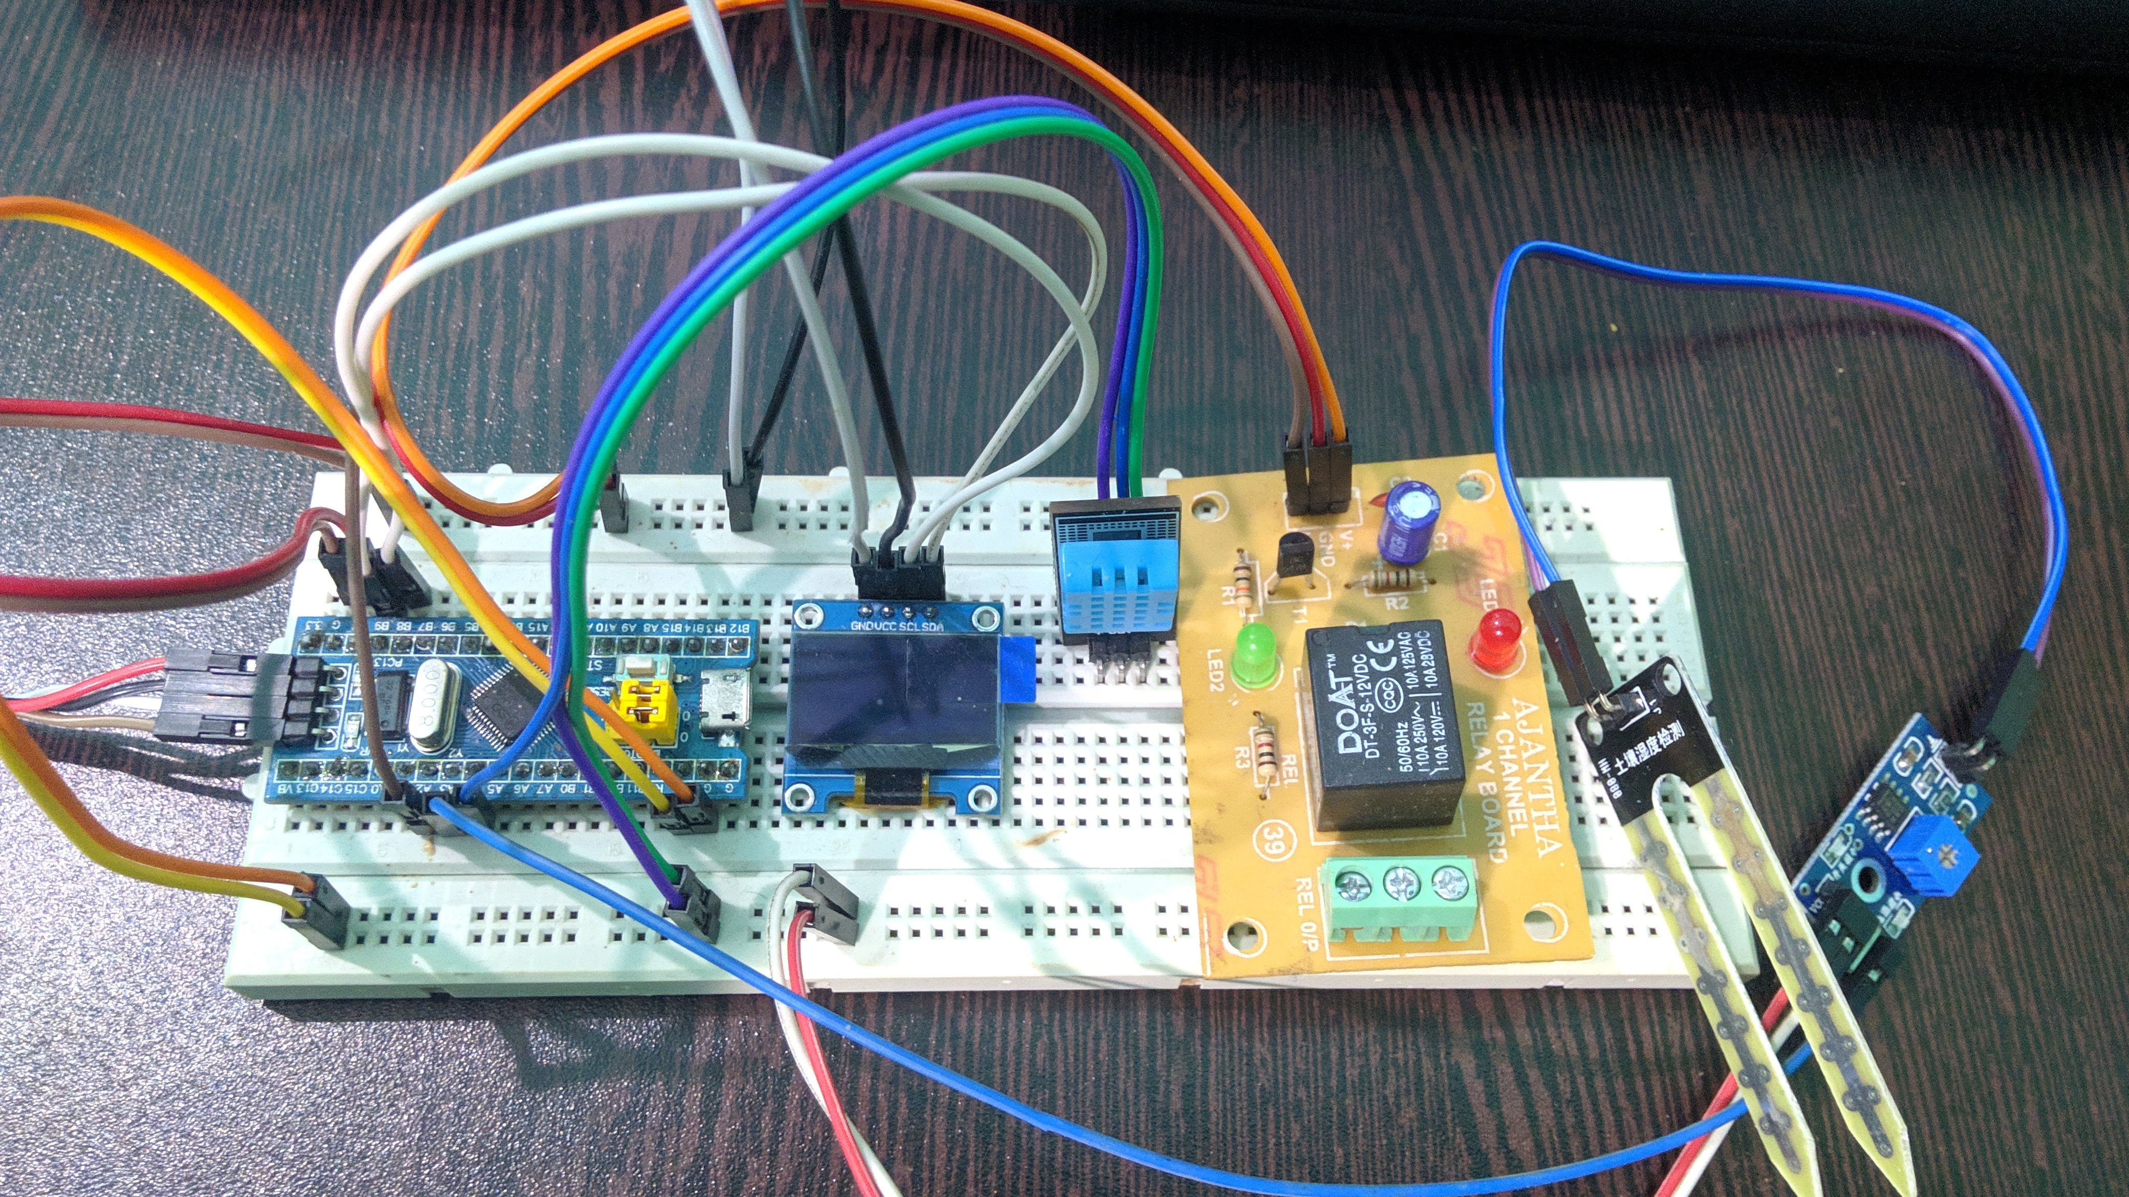

Slide 7
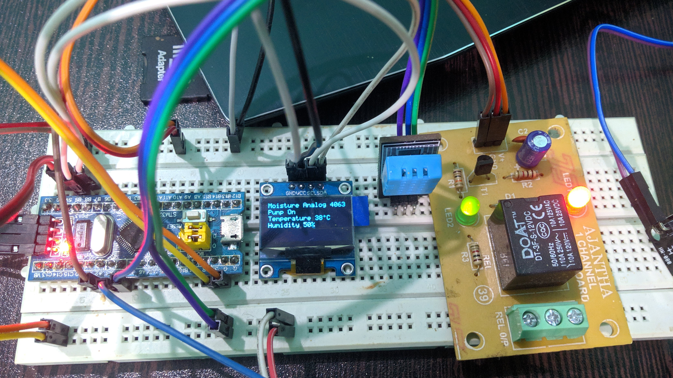
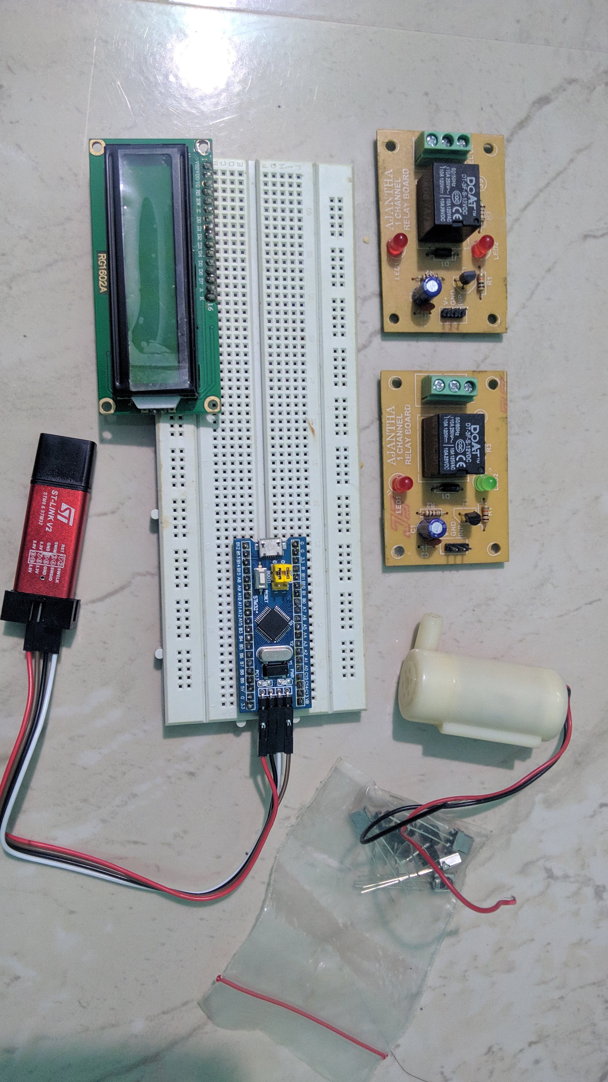

Slide 8
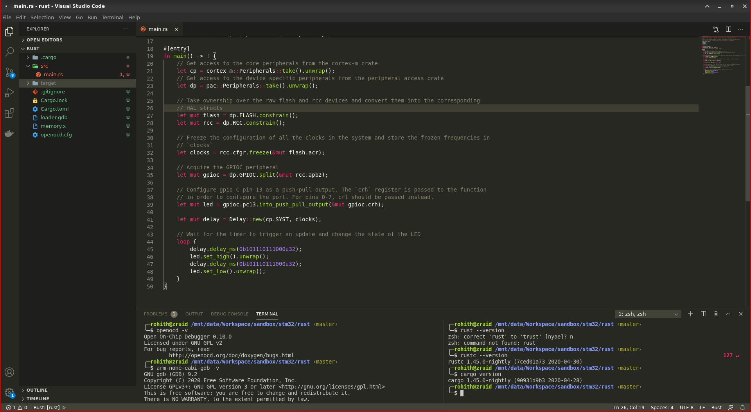

Slide 9
CHALLENGES & DESIGN CONSTRAINTS:
Too many constants in the libraries, So the “.rodata” section fills up quickly.
Since Rust Lang is developing and very young we faced lot of difficulties for referring documentation.
DHT sensor where there is Timing Critical, We may have to modify the DHT library according to data sheet & have to halt all other interrupts in the system.
String interpolation for OLED Library, was a problem but now we have resolved with “HEAPLESS” library.

Slide 10
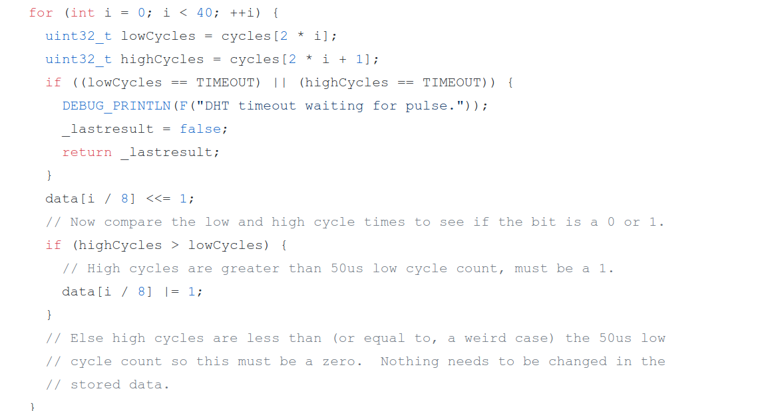
Timing Error Handling^{[7]}

Slide 11
Conclusions
We successfully built a Smart Agriculture system with ARM Cortex M3 based STM32F103 Blue Pill using Rust Language.
Eventhough it is a new language in the embedded space, we were able to implement it for our use case through reading extensive documentation.

Slide 12
references
[1] Image 1, STM32F103: ARM Cortex M3 Microcontroller
[2] The Embedded Rust Book
[3] Documentation | Open On-Chip-Debugger
[4] GDB: The GNU Project Debugger Documentation
[5] README.md, Line 200, 250, 528, 553 | Rust Awesome - Curated Rist Libraries
[6] STM32F10XX_HAL Documentation, Revision 0.6.1, docs.rs, Rust Documentation
[7] Adafruit DHT Unified Library, Master Branch, DHT.cpp
[8] R. Ramya ; C. Sandhya ; R. Shwetha, Smart farming systems using sensors, 2017 IEEE Technological Innovations in ICT for Agriculture and Rural Development (TIAR), April 2017
[9] G. Arvind ; V. G. Athira ; H. Haripriya ; R. Akshaya Rani ; S. Aravind, Automated irrigation with advanced seed germination and pest control, 2017 IEEE Technological Innovations in ICT for Agriculture and Rural Development (TIAR), April 2017
[10] Chetan Dwarkani M ; Ganesh Ram R ; Jagannathan S ; R. Priyatharshini, Smart farming system using sensors for agricultural task automation, 2015 IEEE Technological Innovation in ICT for Agriculture and Rural Development (TIAR), July 2015

Slide 13

Thank You!

